Slide 1
CURSOR MOVEMENT BY HAND GESTURES
REVIEW-3
T. TEJAS – 18BEC0396
AKSHAR K. – 18BEC0863
NAMAN KHANDELWAL – 18BEC0871

Slide 2
ABSTRACT
Hand tracking based virtual mouse application, which can be implemented using a regular webcam.
Using a camera and computer vision technology, such as image segmentation and gesture recognition, to manage mouse tasks (left and right clicking, double-clicking, and scrolling).

Slide 3
PROJECT SPECIFICATIONS
Software Specifications
64-bit Operating System: Windows 8 or Higher
OpenCV 2.4.9 needs to be installed prior to running.
Windows Administrator permissions are needed for some parts of the program to
function properly.
Hardware Specifications:
A Webcam
Environment Specifications:
A clear white background
There should be no other objects (specially skin coloured objects) in front of the webcam
other than your Palm.

Slide 4
PROPOSED SYSTEM
The input frame would be captured from the digital camera and system is broken down into five stages:
Skin Detection
Hand Contour Extraction
Hand Tracking
Gesture Recognition
Cursor Control

Slide 5
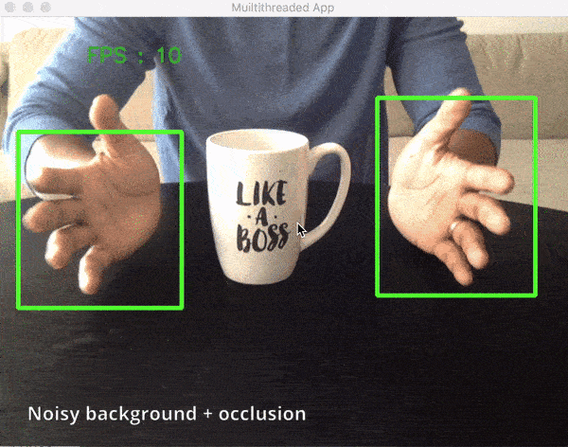
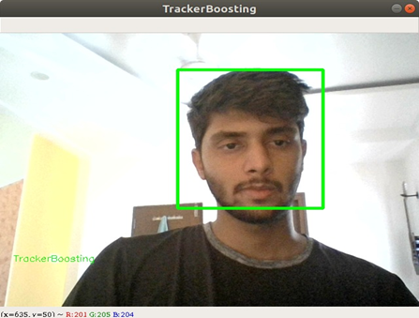
SKIN DETECTION
Skin detection can be defined as detecting the skin color pixels in an image. It’s affected by illumination and background.

Slide 6
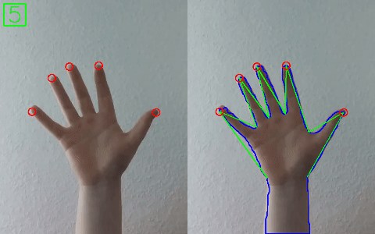
HAND CONTOUR EXTRACTION
Edge detection is performed to get the hand contours within the image and the movement is implied.

Slide 7
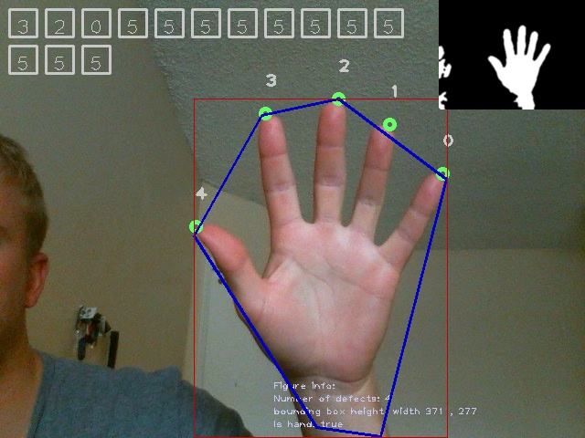
HAND TRACKING
To spot the tip of the finger, the centre of the palm should be found first. Using the hand center, the tip of the finger can be known and used for hand tracking.

Slide 8
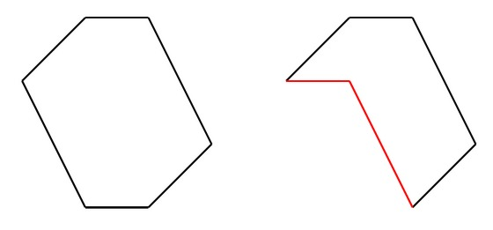
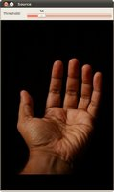
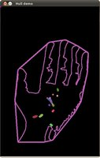
Convex Hull
The convex hull of a set of points is defined as the smallest convex polygon, that encloses all of the points in the set. Convex means that the polygon has no corner that is bent inwards.

Slide 9
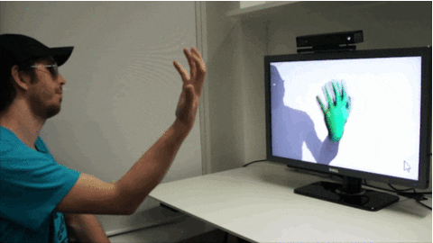
GESTURE RECOGNITION
There are two main steps for gesture recognition:
Fingertip identification
Number of fingers

Slide 10
CURSOR CONTROL
Once the hand gestures are recognized, it’s an easy matter of mapping totally different hand gestures to specific mouse functions.
This can be done by including the ‘pyautogui’ library into the program, which gives us control over the cursor’s inbuilt functions.

Slide 11
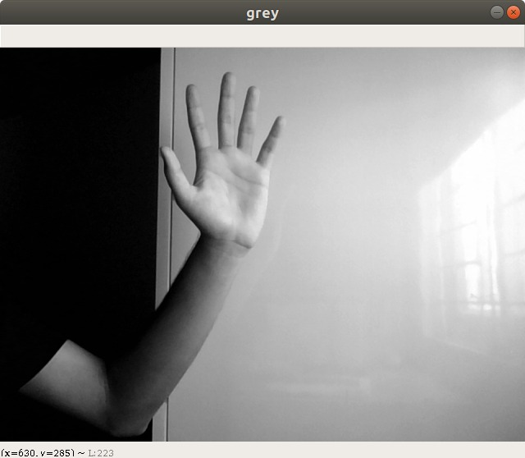
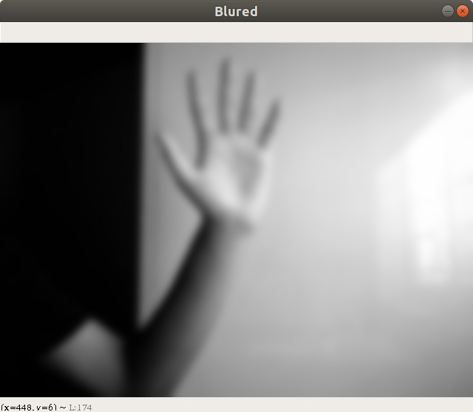
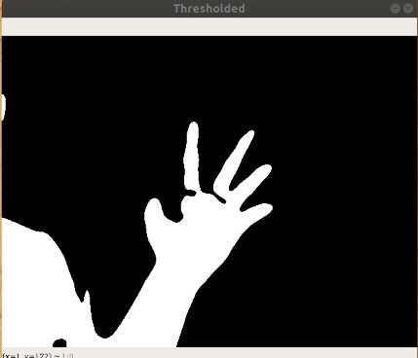
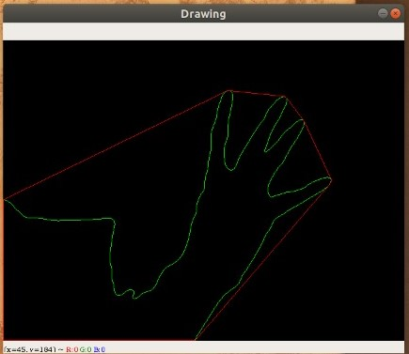
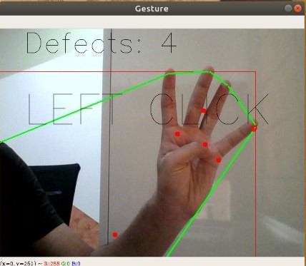
IMPLEMENTATION
Grey Image
Blurring
Thresholding
Contours
Gestures

Slide 12
CONCLUSION
The system control the mouse pointer and implement its operation using a real time camera. The goal of this project is to form a system which will acknowledge the hand gestures and control the computer/laptop in line with those gestures.

Slide 13
REFERENCES
1) OpenCV Website – www.opencv.org
2) MSDN Microsoft developers network – www.msdn.microsoft.com
3) Code project – www.codeproject.com/Articles/498193/Mouse-Control-via-Webcam
4) Aniket Tatipamula’s Blog - https://anikettatipamula.blogspot.in/2012/02/hand-
gesture-using-opencv.html
5) https://theailearner.com/tag/cv2-convexitydefects/

